Slide 1





TRAFFIC MANAGEMENT
Name : R.Dhivakar
Email : dhivakarbemechanical@gmail.com
NM I’D : au811221114008,
edunet:E59B1BEB6C218879FBA4D3631D3BCBDC
Guide:P.Raja
Disclaimer: The content is curated for educational purposes only.
Notes:
Slides: Prepare a short slide deck (10-12 slides) summarizing the project objectives, methodology, and key results.

Slide 2
TRAFFIC MANAGEMENT
OUTLINE
Abstract of the Project
Problem Statement
Proposed Solution
System Architecture
Live Demo of the Project
Embedded Video of Project
Conclusion
Future Scope

Slide 3
Abstract
TRAFFIC MANAGEMENT
Traffic management refers to the strategies and practices employed to optimize the flow of vehicles and pedestrians on road networks. Its primary goals are to reduce congestion, enhance safety, and improve overall transportation efficiency. Effective traffic management involves a combination of infrastructure design, traffic control devices, and technology, such as traffic signals, signage, and intelligent transportation systems (ITS).

Slide 4
Problem Statement
TRAFFIC MANAGEMENT
Reduce Congestion : These systems use real-time data and advanced algorithms to dynamically adjust and coordinate traffic signals, ensuring a smoother flow of vehicles.
Optimize traffic flow: The involves employing various advanced techniques to analyze, predict, and manage the movement of vehicles more efficiently.
Improve transportation effciency: Improving transportation efficiency through AI-based traffic management involves a combination of real-time data analysis, predictive modeling, and smart infrastructure

Slide 5
Proposed Solution
TRAFFIC MANAGEMENT
Real-time traffic monitoring: Real-time traffic monitoring involves the continuous observation and analysis of traffic conditions using advanced technologies to provide up-to-the-minute data on traffic flow, congestion, and incidents.
Machine learning-based traffic prediction: Machine learning-based traffic prediction uses algorithms to analyze historical and real-time traffic data, enabling the forecasting of traffic patterns, congestion, and flow. This predictive approach helps optimize traffic management and improves transportation efficiency
Intelligent traffic signal control: Intelligent Traffic Signal Control (ITSC) is an advanced traffic management system that uses real-time data, machine learning, and artificial intelligence to optimize traffic signal timings and enhanced safety,reduce congestion
Data analytics for optimization: Leveraging large datasets from sensors, cameras, and connected vehicles, traffic management systems can identify patterns, predict traffic conditions, enhance decision-making, optimize traffic flow and optimize various aspects of the transportation network.

Slide 6
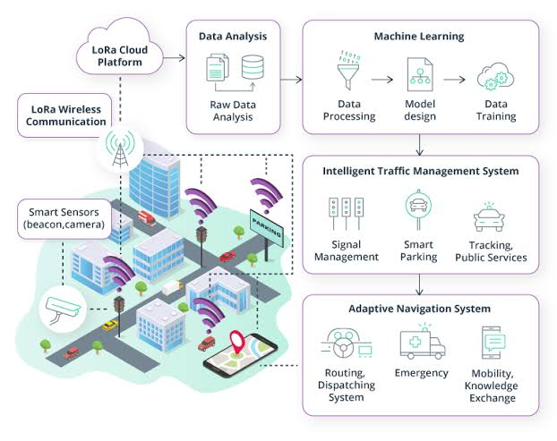
System Architecture
TRAFFIC MANAGEMENT

Slide 7

Live Demo of Project
TRAFFIC MANAGEMENT

Slide 8
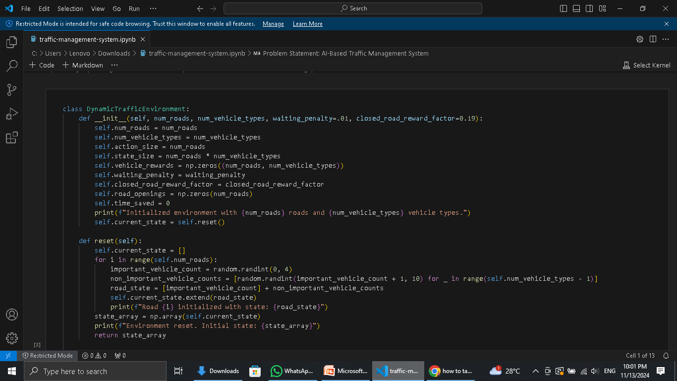
TRAFFIC MANAGEMENT
Video of Project Demo

Slide 9
Conclusion
TRAFFIC MANAGEMENT
This traffic management analysis used machine learning to optimize signal timings, with Random Forest achieving 85% accuracy. Key findings included peak hour congestion (7-9 am, 4-6 pm) and weather's impact on traffic flow. Implementing Random Forest models and integrating relevant data can improve congestion mitigation, route planning, safety, and efficiency.

Slide 10
Future Scope
TRAFFIC MANAGEMENT
Potential applications:
Smart cities.
Intelligent transportation systems.
Traffic management for events.
Future developments:
Integration with other systems (e.g., public transportation).
Expansion to other areas (e.g., pedestrian traffic).
Integrate additional data sources (e.g., social media, sensors).
Explore deep learning architectures for improved accuracy.
Develop transfer learning models for adaptability.

Slide 11
TRAFFIC MANAGEMENT
Thank you!
Notes:
thank you very much for joining this PPT, keep learning.
11

